Slide 1
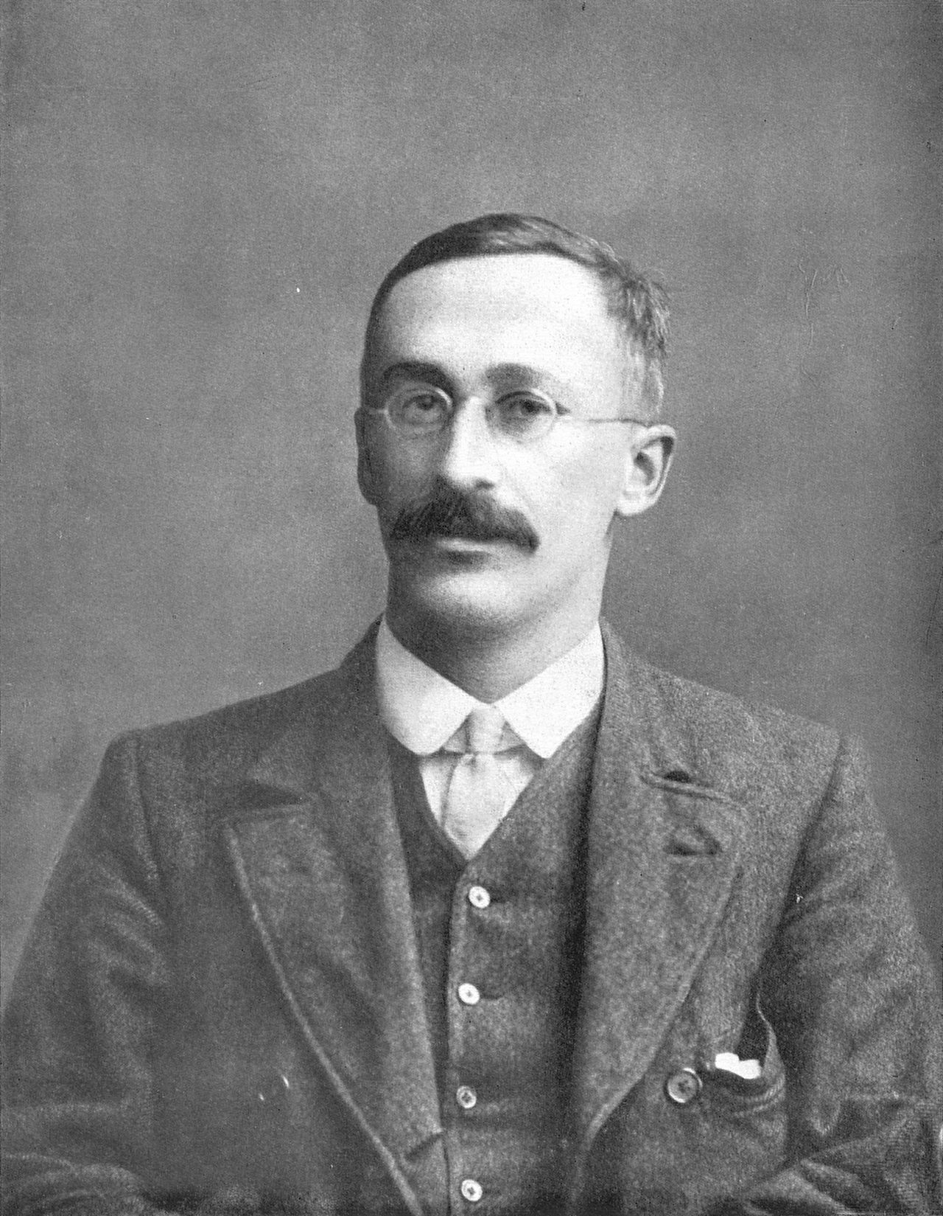
The paired t test
These slides and all materials are available through GitHub:
https://github.com/ben-arnold/pairedttest_201804
https://upload.wikimedia.org/wikipedia/commons/4/42/William_Sealy_Gosset.jpg
Ben Arnold, PhD
Division of Epidemiology and Biostatistics
University of California, Berkeley
April 4, 2018
William Sealy Gosset (“Student”)
1876 - 1937
Notes:
This is a portrait of William Sealy Gosset who derived the t-distribution and the t test
There are many interesting historical footnotes to his original 1908 Biometrika paper. One interesting fact that I'd like to share with you is that he worked for Arthur Guinness and Company. Now, another researcher at Guinness had previously published brewery trade secrets. So the company had forbidden its employees to publish any scientific papers. It was in their contract.
After Gosset wrote up his work on the t distribution, he pleaded with his bosses to let him publish it because it contained no trade secrets whatsoever. And they finally let him publish but he had to use a pseudonym “Student” to avoid any possible link to the brewery. So that is part of the backstory and there are many other entertaining details that I encourage to explore through some of the references at the end of this lesson.

Slide 2
By the end of this lesson, you will have all the tools you need to lead the analysis for a $10 million cluster randomized trial.
Notes:
And I’m 100% serious when I say

Slide 3
Learning Objectives for this lesson
You will learn:
Study design considerations that motivate a paired t test
Assumptions, arithmetic, and how to compute a paired t test
Why the paired t test has lower variance compared to a t test that compares means from two independent samples.
Notes:
Now we’ll get there through 3 learning objectives:

Slide 4
Designs that motivate a paired t test

Slide 5
Matched or blocked designs with quantitative outcomes measured in pairs motivate the paired t test

Slide 6
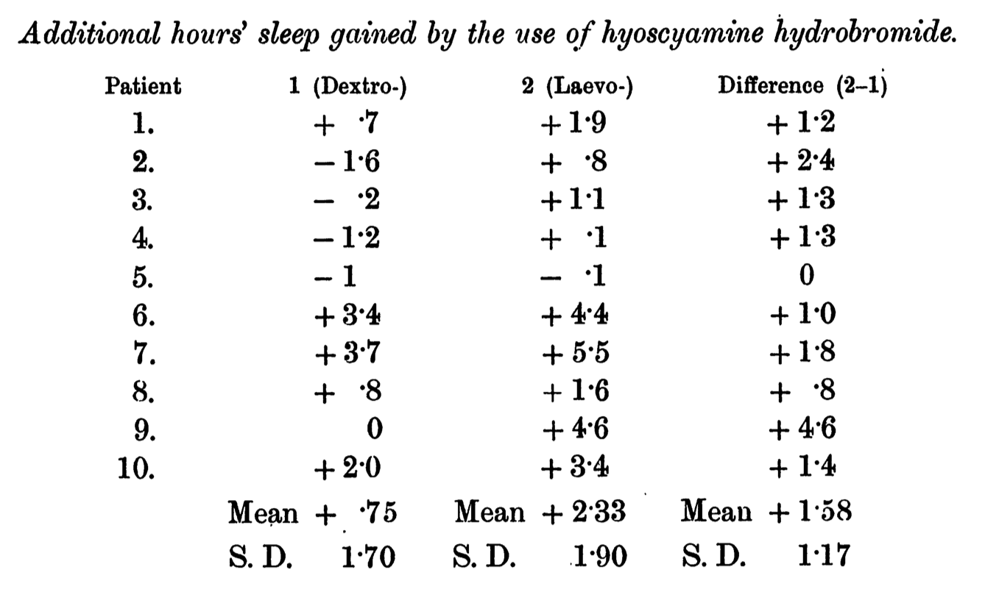
Example: the first t test…
was a paired t test!
Student. Biometrika. 1908; 6(1): 1-25.
Notes:
.... was a paired t test
The example that Gosset used was a trial from Kalamazoo Michigan that measured the additional hours of sleep gained under the two treatments for 10 individual patients.
The analysis focused on the difference in outcomes between the two treatments.
And this is going to be a key insight for us today.

Slide 7
Key point:
In a paired analysis, the independent unit is a pair and the analysis focuses on a single outcome: the within-pair difference
Student. Biometrika. 1908; 6(1): 1-25.

Slide 8
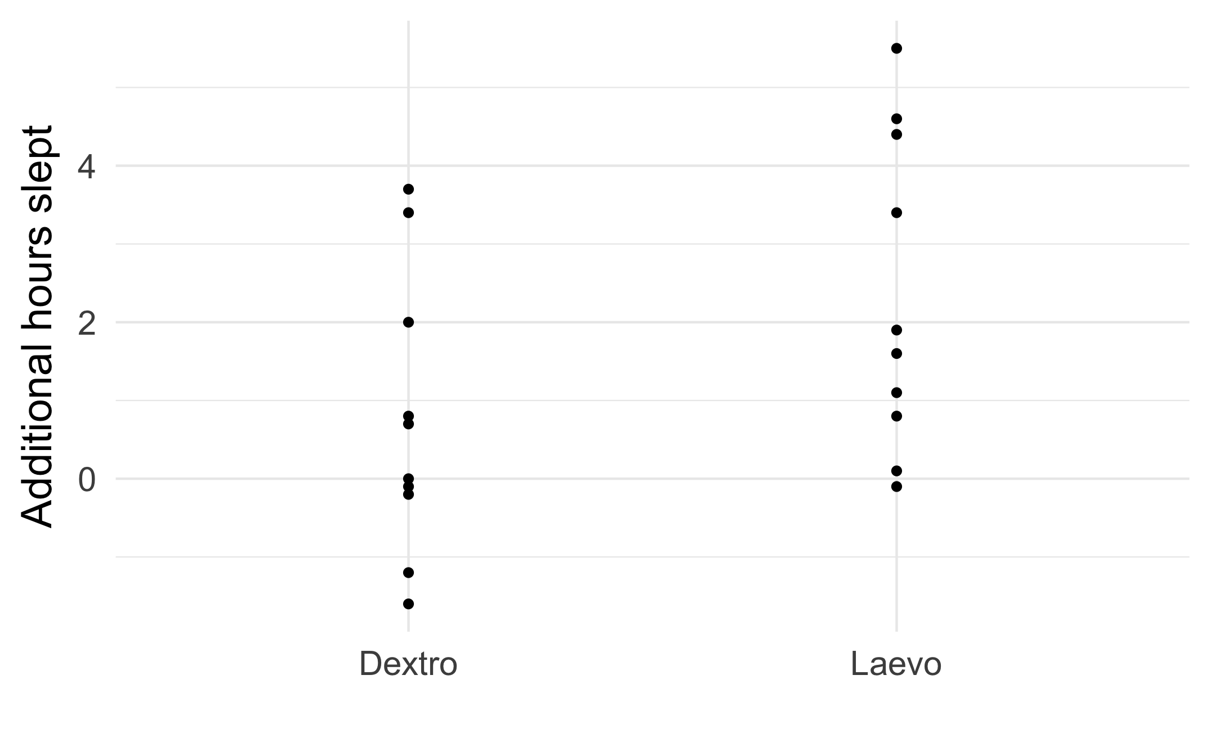
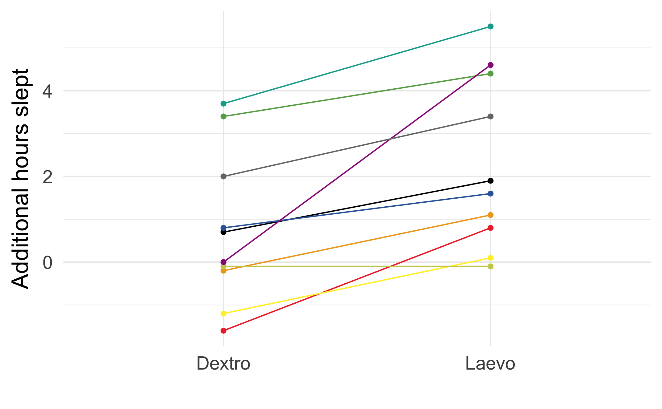
Key point:
By calculating paired differences within individual patients, the study removed between-individual variability in sleep improvement
Student. Biometrika. 1908; 6(1): 1-25.
Notes:
But if we examine the paired outcomes within individuals, which I’ve highlighted here with color and lines that connect them, we can see a couple of important things.
First, there a lot of the variation between individuals in sleep improvement.
Second, the variation between individuals is generally larger than the difference of treatment within any one patient.
So in this case, there is a lot of benefit to pairing measurements within the same patient.
By using individuals as their own control, we effectively sweep out the between individual variation in sleep improvement, and can focus in on the difference between drugs.

Slide 9
Study design: control of variation
When estimating the effect of a treatment on an outcome, it helps to remove other sources of variation in the outcome to the extent possible through the study’s design
Rationale:
Efficiency: you can enroll fewer participants and still isolate the effect of an exposure or treatment on the outcome, without it getting lost in the “noise” (other sources of variation)
Bias control: Stratification or matching in the design ensures the characteristics used to stratify/match are balanced across treatment groups
Notes:
And this is a general strategy that we use in study design.

Slide 10
Matched experimental designs (trials)
Matching in the design of a trial will usually help in terms of bias and variance
The main costs of matching in a trial:
Costs of obtaining information used to match units
Reduces the degrees of freedom in the analysis
Loss in degrees of freedom is almost never a problem when the number of pairs is greater than 15
Hsu & Lachenbruch, Encyclopedia of Biostatistics, 2005, doi:10.1002/0470011815.b2a15112
Notes:
And in the context of experimental designs, which is where we are going to focus today…

Slide 11
Geographic pair-matching in field trials
“Place” (where people live) can play an important role in many health outcomes
For field trials that cover large geographic areas, geographic pair matching can be valuable:
Efficiency: if the outcome is spatially correlated, matching ensures that treatment comparisons remove variation associated with geography
Bias control: e.g., protect against unexpected co-interventions that may influence only one geographic area
Notes:
One common type of pair matching that you see in field intervention trials is geographic pair-matching.

Slide 12
Unmatched randomization
← Longitude →
Intervention units
Control units
← Latitude →

Slide 13
Geographic pair-matched randomization

Slide 14
Geographic pair-matched randomization
Identify pairs for
blocked randomization

Slide 15
Geographic pair-matched randomization
Allocate treatment within
each matched pair
Each pair now represents a replicated experiment, controlling for any effects of geography.

Slide 16
WASH Benefits Bangladesh Trial
Lancet Global Health, 2018; 6: e302–e315.
https://www.ncbi.nlm.nih.gov/pubmed/29396217
https://osf.io/wvyn4/
Notes:
This is a contemporary example of a pair-matched trial, which was actually just published earlier this year many years of of work here at Berkeley, Stanford, and the International Center for Diarrheal Disease Research in Bangladesh.
I’m going to use the Bangladesh trial as an example to illustrate the concepts and techniques that we learn today.

Slide 17
Bangladesh Trial: Overview
Geographic pair-matched design
Enrolled 720 clusters (villages) across a large swath of rural Bangladesh
As clusters of pregnant women were enrolled, 8 geographically proximate clusters were blocked (90 blocks), and then randomized to a double-sized control group or one of 6 intervention treatments
Primary outcome: linear growth (length) at age 2 years old among the birth cohort
Many more details in: Arnold et al. BMJ Open 2013 3:e003476,
Luby et al. Lancet Global Health, 2018; 6:e302–e315

Slide 18
in Bangladesh

Slide 19
Geographic pair-matching in Bangladesh (simplified to 2 arms)
Control clusters
Nutrition clusters

Slide 20

Nutritional intervention in WASH Benefits
Behavior Change
Exclusive breastfeeding through 6 months
Continued breastfeeding until 24 months
Encourage micronutrient dense food
+
Nutritional Supplement
Nut-based daily supplement 6 – 24 months
118 kcal/day + fatty acids + micronutrients
www.aliveandthrive.org

Slide 21
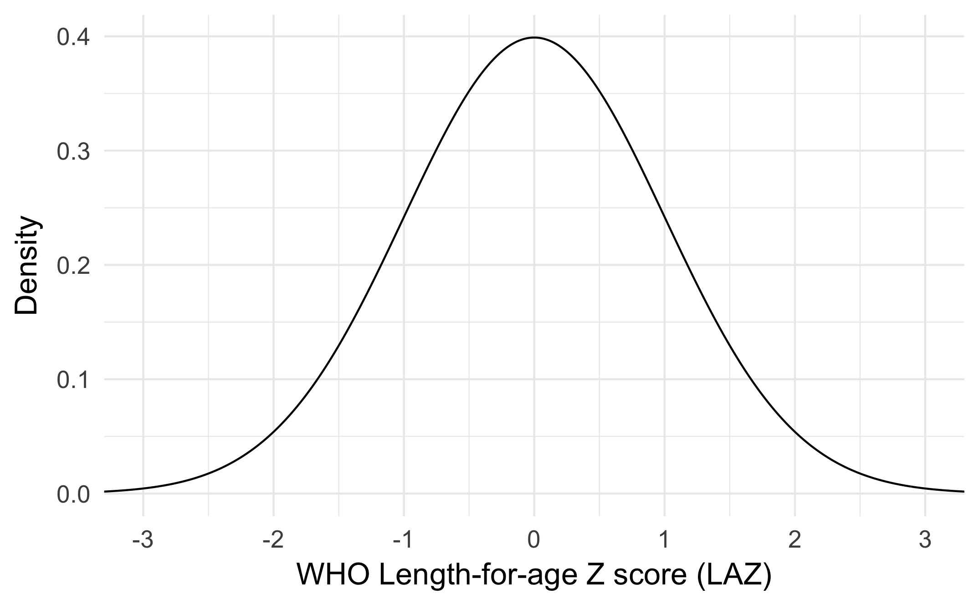
Child length
When children are < 2 years, we often refer to “height” as “length”
A child’s length (cm) can be scaled to WHO international growth reference standards by age and sex
Standardized length measurements are
length-for-age Z-scores (LAZ)
WHO LAZ reference standards have
mean 0 and standard deviation 1

Slide 22
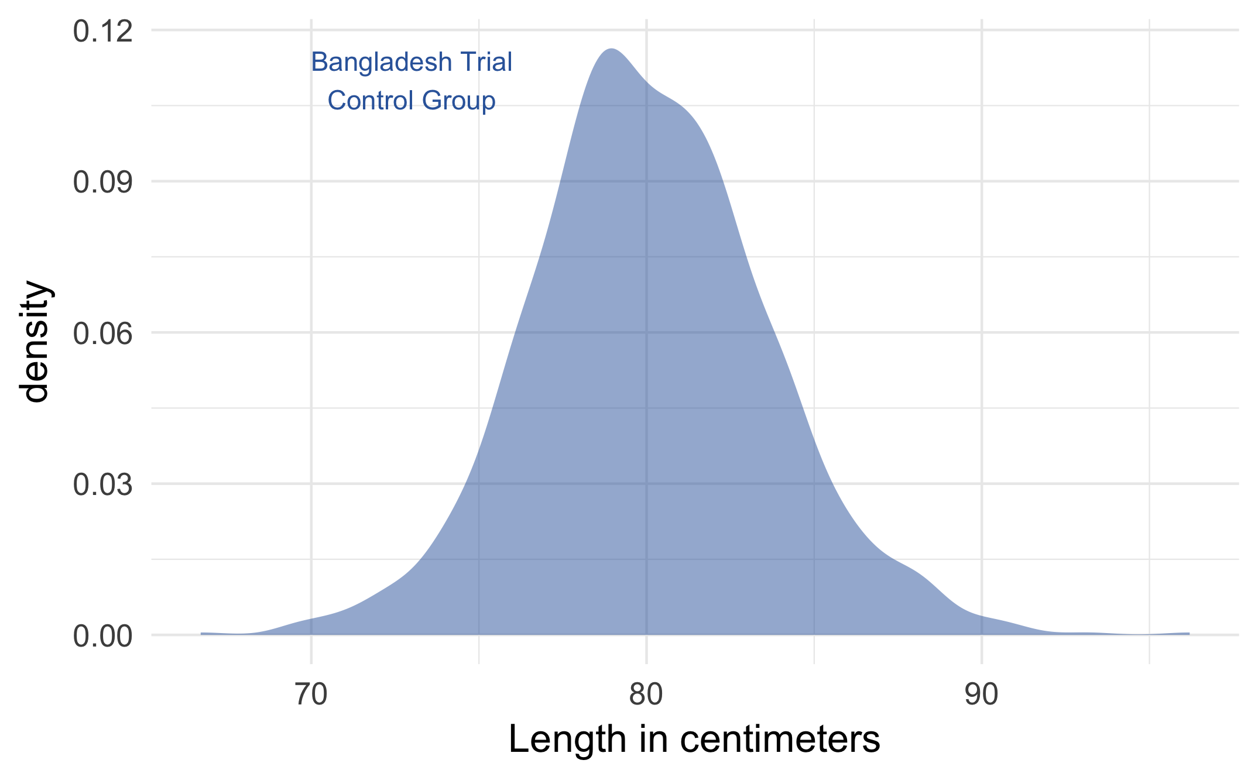
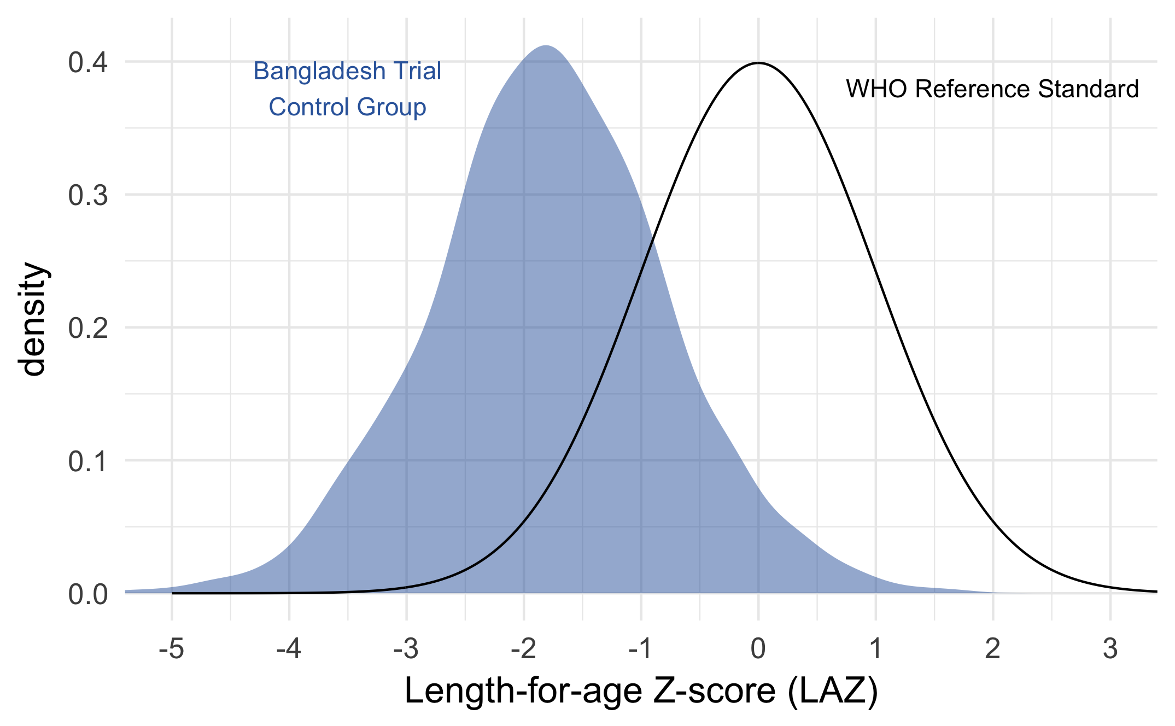
Child length and LAZ in Bangladesh
Length in centimeters
Mean = 80, SD = 4
LAZ
Mean = –1.79, SD = 1.01
N = 1,103 children, median age = 22 months

Slide 23
Assumptions, Arithmetic, and Computing the Paired t Test

Slide 24
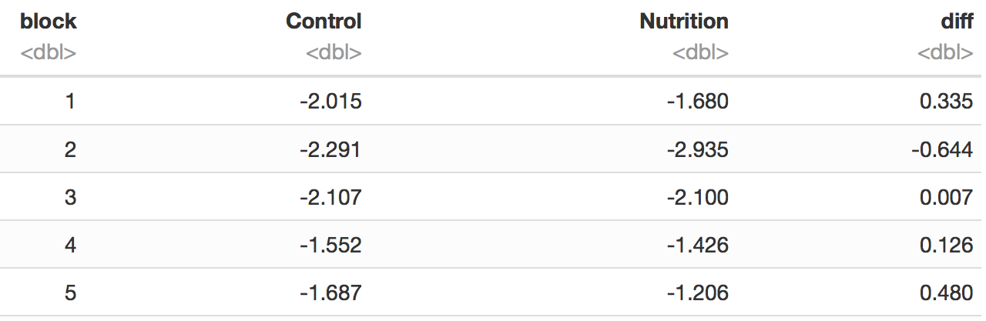
In a paired experiment, we have n pairs of outcome measurements.
Within each pair we observe the outcome among control conditions (Y_{C}) and among intervention conditions (Y_{I}).
The difference within each pair is D = Y_{I} – Y_{C}
First 5 observations from the n = 90 blocks in the Bangladesh trial
Pair (i = 1… n)
Y_{C}
Y_{I}
D = Y_{I} – Y_{C}
…
…
…
…

Slide 25
Key point:
The paired t test is the same as a one-sample t test on the paired differences.
Notes:
And so this really simplifies life a lot!

Slide 26
Assumptions of the paired t test
Pair-wise differences, D, are normally distributed with mean 𝜇_{D} and variance σ_{D}².
If D is highly skewed or there are serious outliers, consider the non-parametric Wilcoxon signed rank test
Each pair must be independent!
Lack of independence among pairs, such as enrolling multiple family members in a sleep study, violates the assumptions of the t test.

Slide 27
Assumption 1: normally distributed differences
We can assess whether the sample distribution of D is compatible with a normal distribution using a quantile-quantile plot and through formal statistical testing, such as the Shapiro-Wilk normality test (not covered today!)
The effect of non-normality is fairly small if n > 30, since by the central limit theorem the distribution of D will be close to normal in that case. *
* Altman DG, Bland JM. Statistics notes: the normal distribution. BMJ. 1995;310: 298.

Slide 28
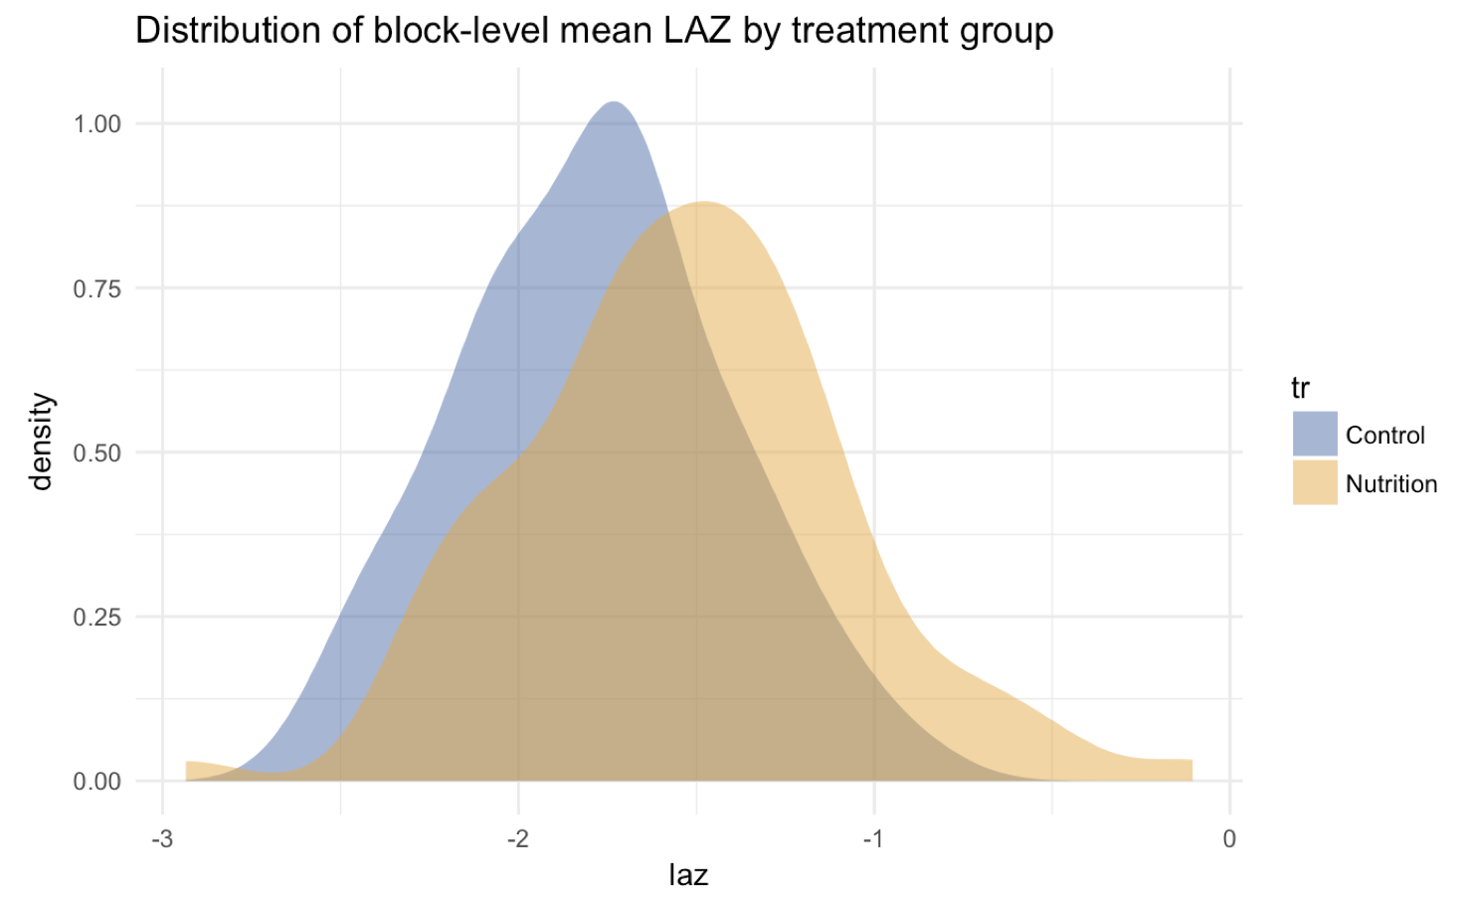
Y_{C}
Y_{I}

Slide 29
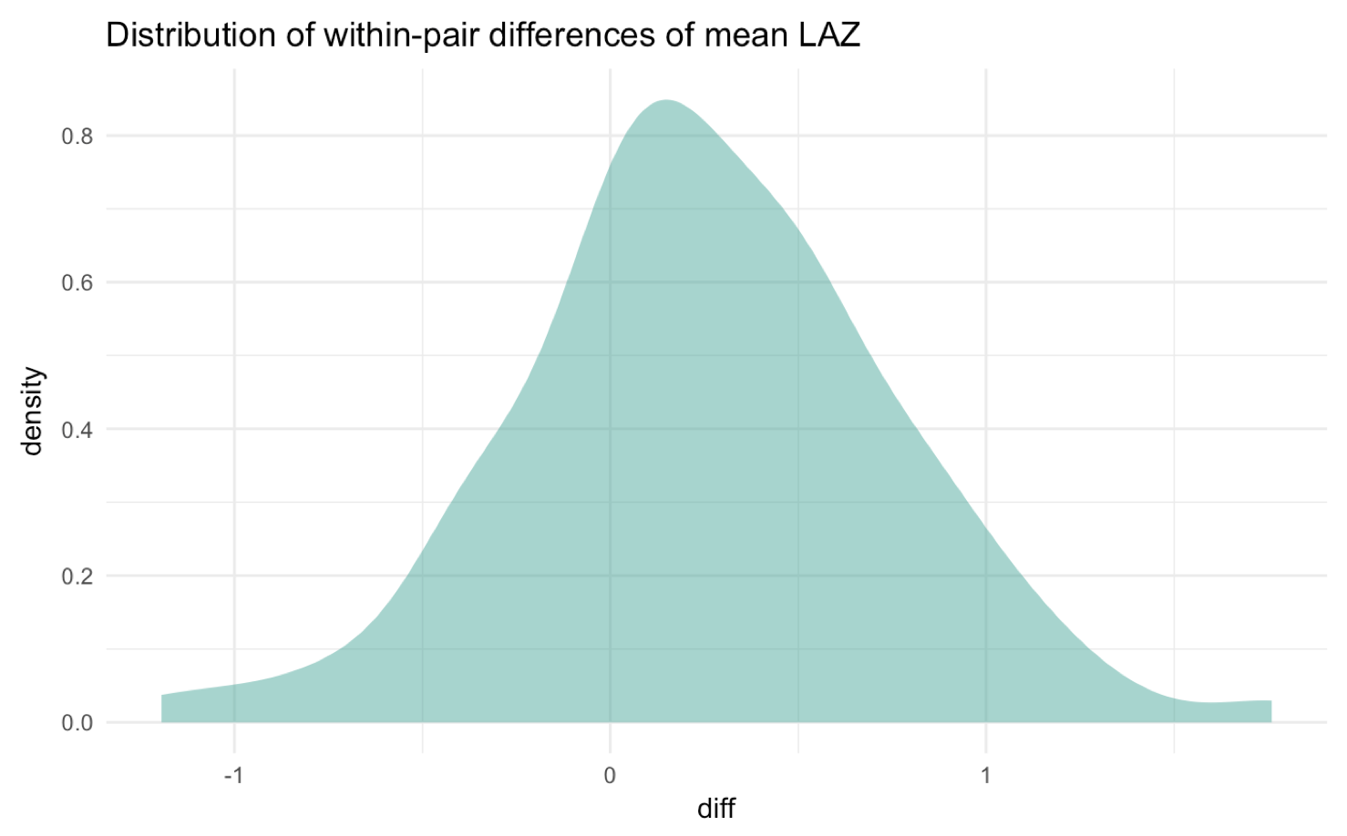
, D_{i}

Slide 30
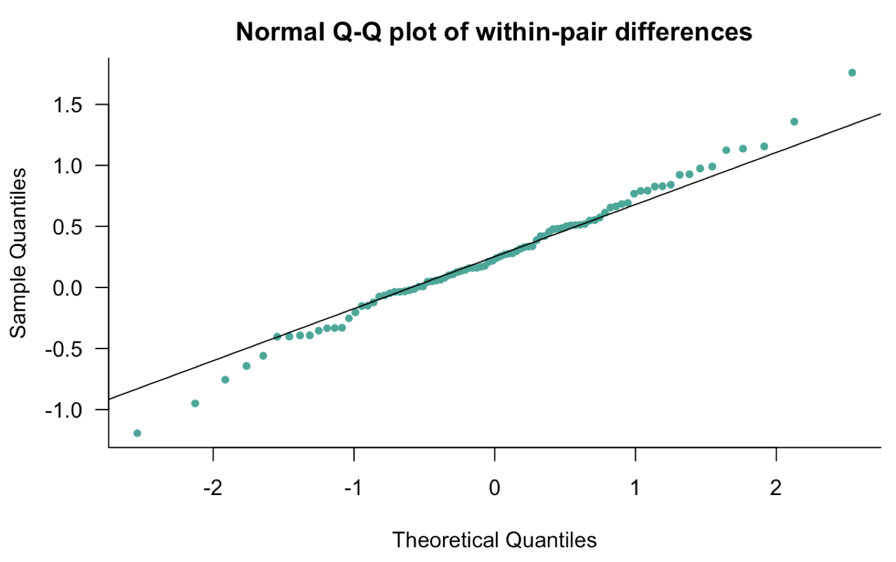
Assumption 1: differences close to normally distributed
, D_{i}

Slide 31
Assumption 2: Independence of pairs
This assumption is often more difficult to verify empirically
In the Bangladesh trial, each cluster was separated by 1 km to prevent “spillover” (contamination) of interventions between clusters *
* A detailed substudy in the trial determined there were no spillover effects:
Benjamin-Chung et al. Am J Epidemiol. 2018; doi:10.1093/aje/kwy046

Slide 32
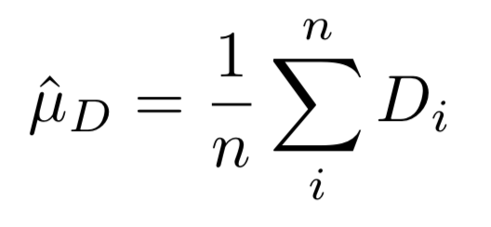
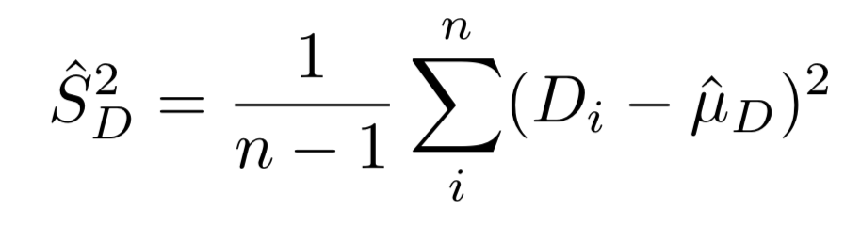
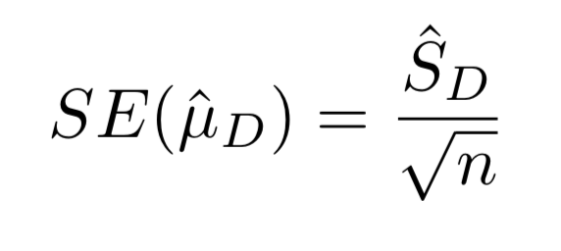
Mean, Variance, and SE of the differences
The mean difference is estimated as:
An estimate of the variance of D is:
An estimate for the standard error of the mean is:
Notes:
And since we are calculating this statistic from a sample of the population, we divide by n-1 instead of n

Slide 33
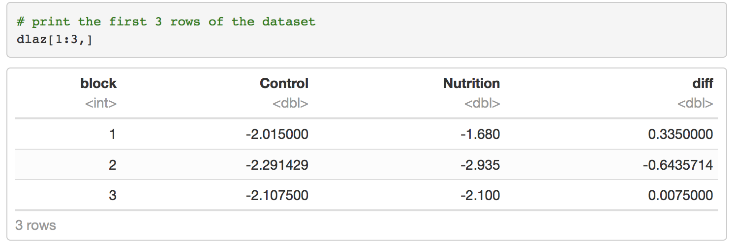
Computing in R

Slide 34
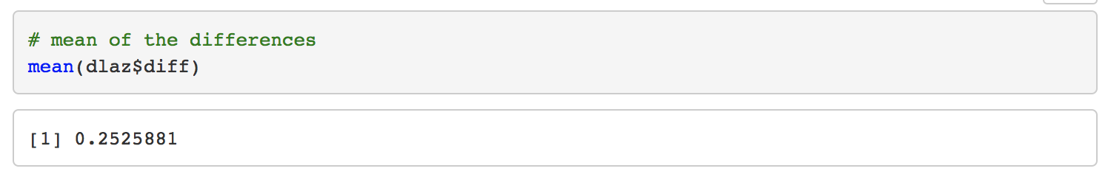
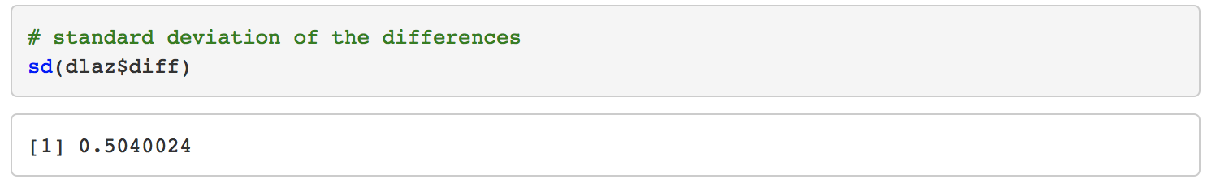
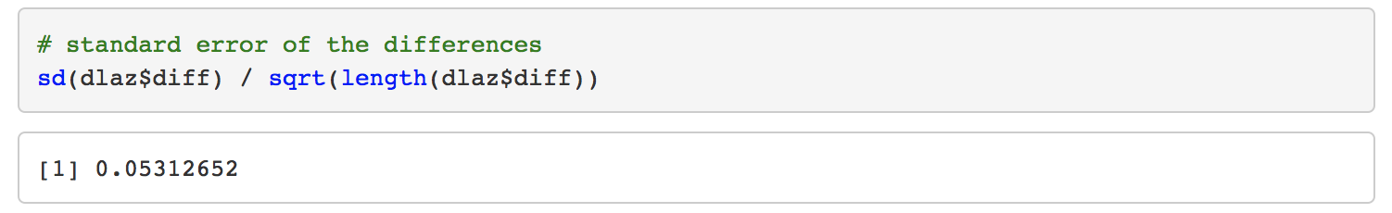
Computing in R

Slide 35
The paired t test
Children who received the nutritional intervention in Bangladesh had mean LAZ +0.25 higher then children in the control group (SE=0.053).
Could chance explain the difference?

Slide 36
Null and alternative hypotheses
Null hypothesis, H₀ : Treatment has no effect
Mean difference between treatment and control is 0: 𝜇_{D} = 0
Alternative hypothesis, H_{A} : Treatment has an effect
Mean difference is not 0. It could be > 0 or < 0: | 𝜇_{D} | > 0
Notes:
A standard way to approach this is to frame the problem in terms of a null hypothesis and an alternative hypothesis.
Another way of thinking about this is that the mean difference between treatment and control is 0.
Another way to frame this is that the mean difference is not 0. It could be >0 or <0.

Slide 37
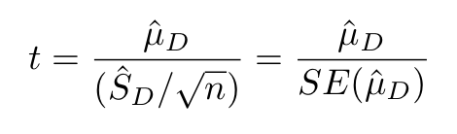
What is the probability of observing a difference as large as +0.25 if the null hypothesis is true?
Calculate a test statistic, equal to the mean divided by its standard error:
= 0.2526 / 0.05313 = 4.75

Slide 38
Under the null, the test statistic t follows a t-distribution with degrees of freedom equal to the number of pairs, n – 1
In the Bangladesh trial, n – 1 = 89 degrees of freedom
How extreme is a value of t = 4.75?

Slide 39
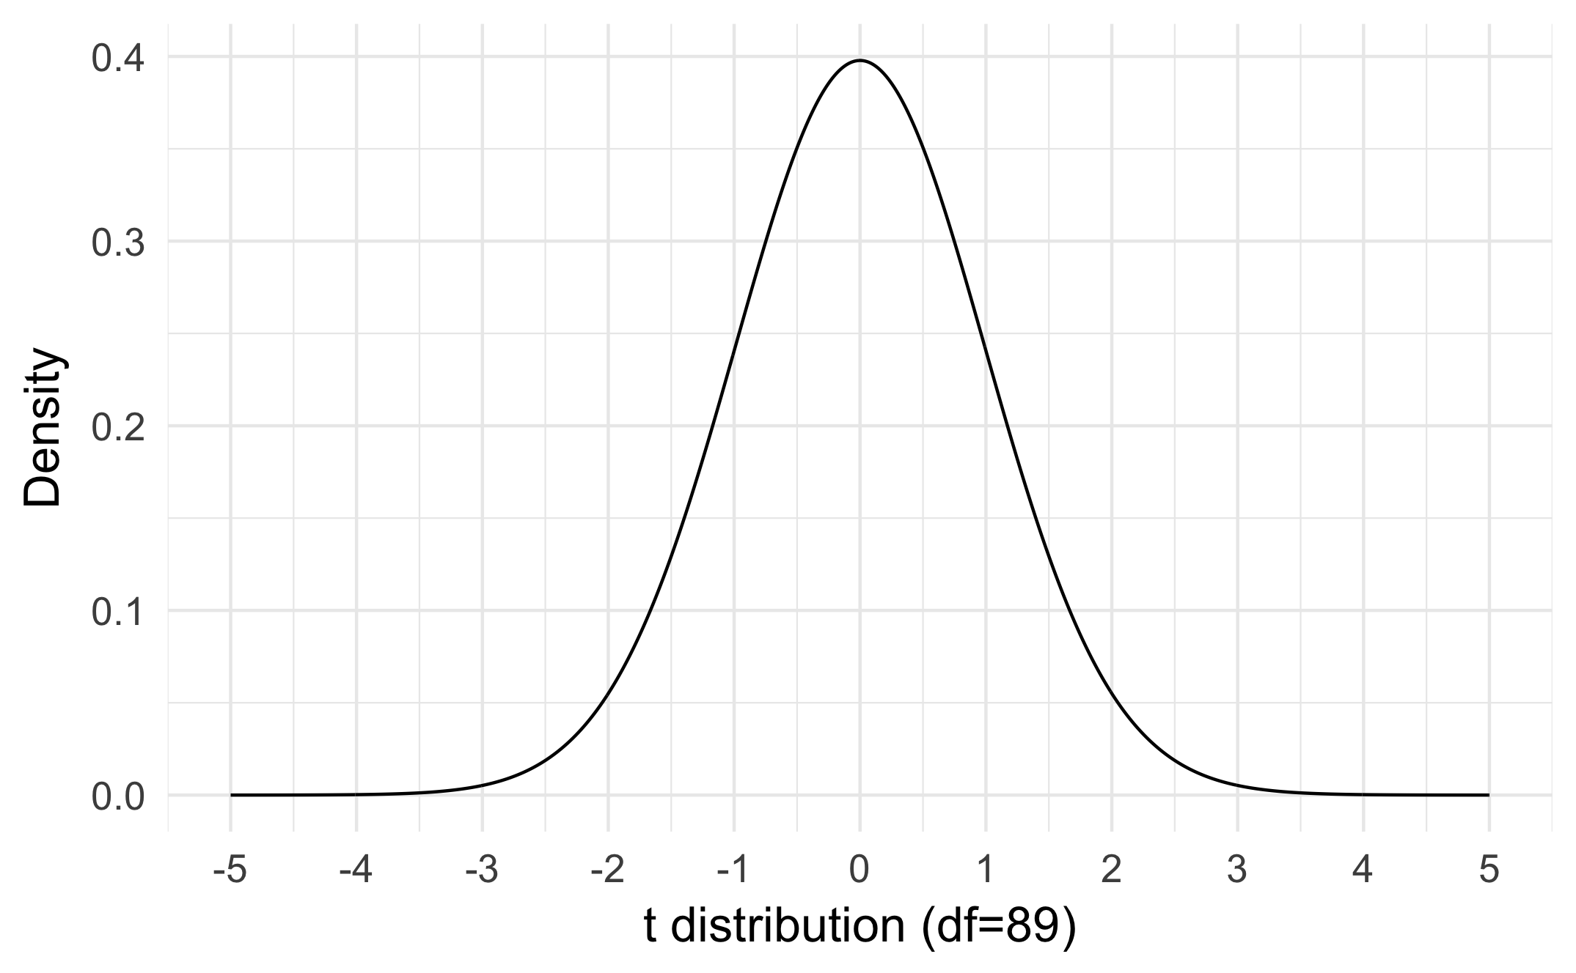
The area under the distribution to the right of 4.75 is the probability of observing a difference 0.25 or greater if the null is true.
For a two-tailed test, take the area under the distribution in either direction beyond ± 4.75
– 4.75
4.75
P( | t_{df=89} | > 4.75) = 0.000008

Slide 40
We conclude that it would be very unlikely (less than 1 in 10,000) to observe a difference of 0.25 by chance if, in fact, there were no effect of improved nutrition

Slide 41
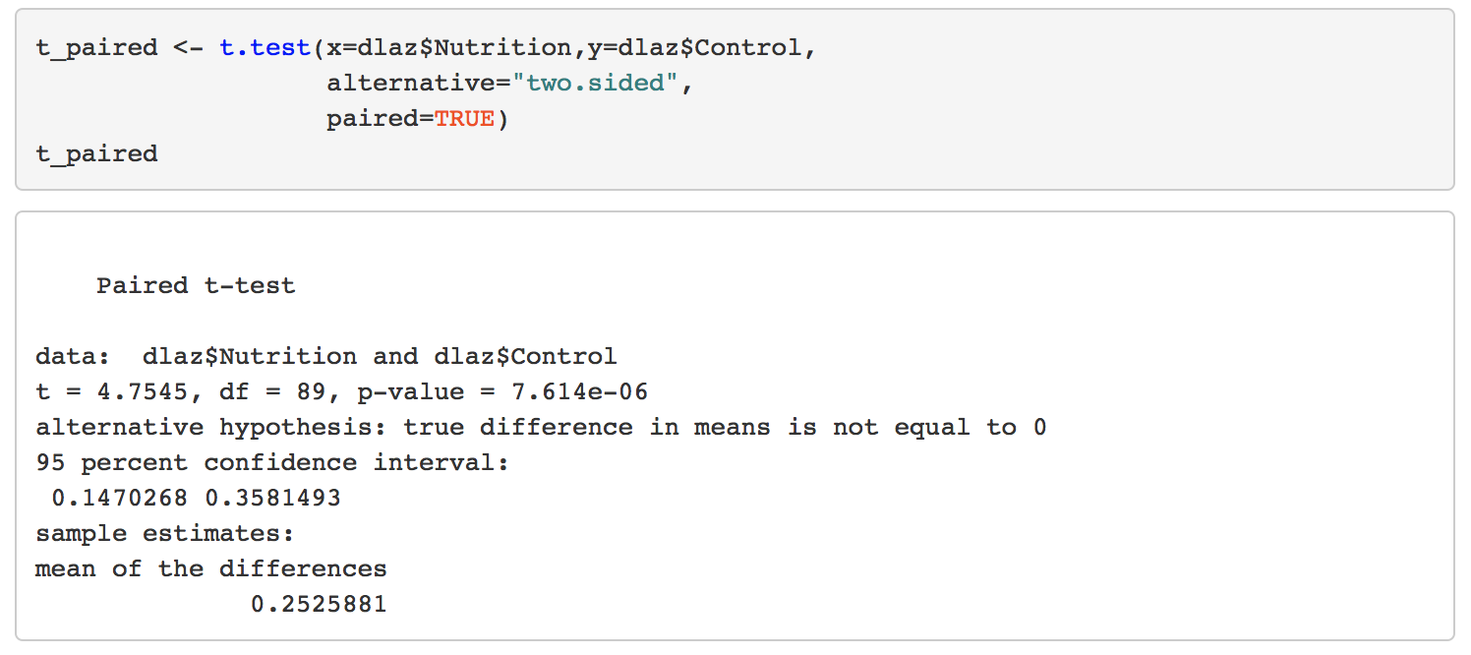
Computing in R
Notes:
We can also estimate confidence intervals from our estimate of the standard error using standard methods.
I’ll talk about that in detail in our next session at 4pm on Friday.

Slide 42
Luby et al. Lancet Global Health, 2018; 6:e302–e315. Figure 3E

Slide 43
Efficiency gains from pair matching
Notes:
So I started off this lesson by making claims that pair matching could improve efficiency in a study, compared with an unmatched design.
And many of you could probably intuit some of this from the figure I showed you from Gosset's original paper, where we could see that by removing the between individual variation in sleep improvement, we could hone in on the treatment effects
I'm not going to get super technical about this, but I'd like to share with you a few more details about why this is and how you might be able to estimate the benefit of pair-matching with respect to efficiency if you are considering it in a design.

Slide 44
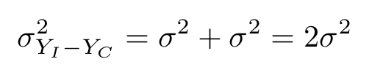
Variance of Y_{I} – Y_{C} in an unpaired design
Assume the variances of Y_{C} and Y_{I} are equal (σ²).
In an unpaired design, Y_{C} and Y_{I} are independent samples.
The variance of the difference between two independent variables is the sum of their variances:
Notes:
As a basis for comparison, let’s start with the variance of an unpaired design.
And we’ll focus on the simplest case: that the variances of outcomes are equal.
All of this is basically the same even if they aren’t.

Slide 45
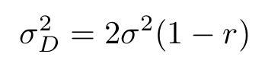
Variance of Y_{I} – Y_{C} in a paired design
Assume the variances of Y_{C} and Y_{I} are equal (σ²).
The variance of their paired differences, D, is:
where r is the correlation between pairs of (Y_{C} , Y_{I} )
Hsu & Lachenbruch, Paired t test. Encycl. of Biostatistics, 2005
Moses. Matched pairs t tests. Encycl. of Stat. Sciences, 2006
Notes:
This is just the same variance as in the unpaired design, but multiplied by this term 1 - r

Slide 46
Efficiency gains from pair matching depend on the correlation of outcomes within pairs
If r = 0, then a paired design and analysis has ____ variance as an unpaired analysis
___ lower ___ higher ___ the same
If r > 0, then the variance in the paired analysis is ____ than in the unpaired analysis
___ lower ___ higher
X
X

Slide 47
By dividing the two variances, the “relative efficacy” of a paired t test is is 1/(1 − r), compared with a two-independent sample t test in a parallel comparison
If r = 0.5, the relative efficacy is? ___
This means that 100 paired observations would have the same power to detect differences as an unpaired study of 200 observations per group.
2
Hsu & Lachenbruch, Paired t test. Encycl. of Biostatistics, 2005

Slide 48
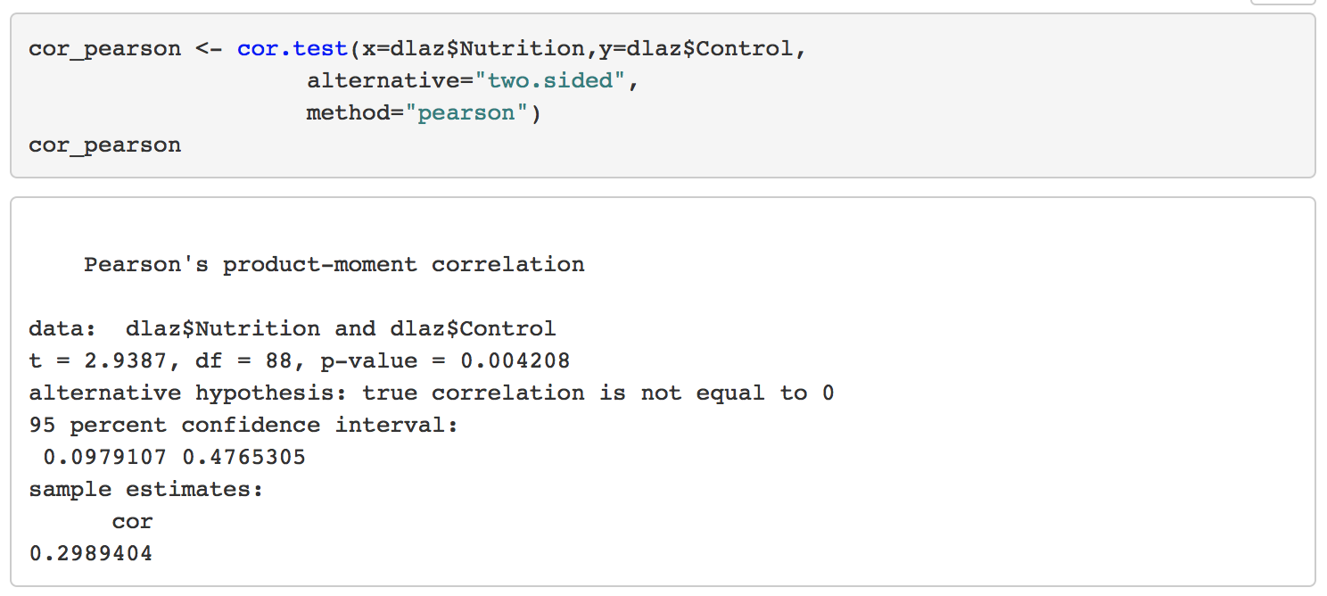
Correlation in the Bangladesh Trial
In the Bangladesh trial the relative efficacy was: 1/(1 – 0.3) = 1.43.
This suggests we would have needed to enroll 90 x 1.43 = 128 clusters per group without pair matching to have had similar power to the geographic pair-matched design in a t test analysis of cluster-level means.

Slide 49
Recap
Paired t tests are motivated by matching or blocking in the design, where outcomes are measured in pairs
Matching in the design can improve efficiency in an analysis, and control for bias by controlling for variation associated with matching characteristics
The increase in efficiency in a matched pairs t test compared with an unmatched t test depends on the correlation of outcomes within pairs
Paired t tests are an “oldie but goodie” : still relevant 110 years later!

Slide 50
Additional Resources
Khan Academy module on hypothesis testing and p-values:
https://www.khanacademy.org/math/statistics-probability/significance-tests-one-sample/more-significance-testing-videos/v/hypothesis-testing-and-p-values
Reference Articles:
Altman & Bland. Statistics notes: the normal distribution. BMJ. 1995;310: 298.
Hsu & Lachenbruch, Paired t test. Encycl. of Biostatistics, 2005, doi:10.1002/0470011815.b2a15112
Moses. Matched pairs t tests. Encycl. of Stat. Sciences, 2006, doi:10.1002/0471667196.ess1551
Senn & Richardson. The first t-test. Statistics in Medicine. 1994; 13:785-803.

Slide 51
extra slides

Slide 52
Exercises on your own:
If W.S. Gosset (“Student”) had analyzed the Kalamazoo sleep trial naively, using an independent two-sample t test, what would his conclusion have been, assuming his threshold for significance was P < 0.005?
Based on the information measured from the 10 patients enrolled in the Kalamazoo sleep trial, how many patients would the trial have needed to enroll if it had allocated patients to separate treatment arms, measuring each patient’s sleep improvement once, rather than comparing paired outcomes within individual patients?

Slide 53
Interesting historical footnote:
W.S. Gosset (“Student”) made a mistake when he copied data from the original trial, and R.A. Fisher perpetuated the mistake in his book Statistical Methods for Research Workers (through its 5th edition)
The medical (but not statistical) conclusions were all wrong.
It also probably wasn’t the very first t test:
Senn & Richardson. The first t-test. Statistics in Medicine. 1994; 13:785-803.

Slide 54
Senn & Richardson. The first t-test. Statistics in Medicine. 1994; 13:785-803.

Slide 55
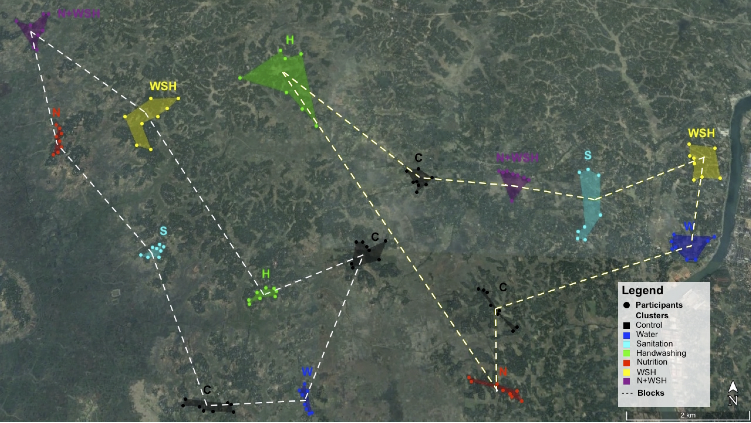
Aerial view of 2 matched blocks in the trial
Complements of Ayse Ercumen

